Slide 1
What is raid?
RAID is the term used to describe a storage systems' resilience to disk failure through the use of multiple disks and by the use of data distribution and correction techniques. RAID stands for:
Redundant Array of Inexpensive or Independent Disks

Slide 2

Software and / or Hardware
RAID can be Software, Hardware or a combination of both. Generally speaking, Software RAID tends to offer duplication or mirroring, whilst Hardware RAID offers Parity-based protection.

Slide 3
Cont….
Software RAID uses more system resources as more disk ports and channels are required and it is subject to additional load during write and copy operations. Software RAID may have a lower cost than hardware RAID because it has no dedicated RAID controller, but may not have the same hotfix or performance capabilities. Software RAID is needed for mirroring to remote locations.

Slide 4
HARDWARE RAID
Hardware RAID offloads Parity generation and checking from the host, and also leaves the host unaffected by internal operations such as rebuilds. Hardware RAID allows for greater disk capacity per disk port. Hardware RAID requires the expense of a RAID controller per subsystem. Hardware RAID systems themselves can also be mirrored with software mirroring.

Slide 5
Level 0
RAID level 0 does not provide fault tolerance. This level is also known as disk striping, because it uses a disk file system called a stripe set. Data is divided into blocks and is spread in a fixed order among all the disks in the array. RAID level 0 improves read and write performance by spreading operations across multiple disks, so that operations can be performed independently.

Slide 6
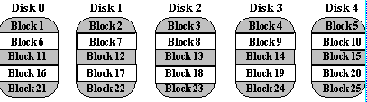
:
Sequential blocks of data are written across multiple disks in stripes, as follows

Slide 7
Level 1
RAID level 1 provides fault tolerance. This level is also known as disk mirroring because it uses a disk file system called a mirror set. Disk mirroring provides a redundant, identical copy of a selected disk. All data written to the primary disk is written to the mirror disk. It also generally improves read performance (but may degrade write performance).

Slide 8
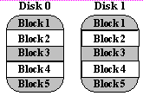
Level1

Slide 9
Recommended Applications
Video Production and Editing
Image Editing
Pre-Press Applications
Any application requiring high bandwidth

Slide 10
Level 2
RAID level 2 uses error correcting algorithm that employs disk-striping strategy that breaks a file into bytes and spreads it across multiple disks. The error-correction method requires several disks. RAID level 2 is more advanced than Level 0, because it provides fault tolerance, but is not as efficient as other RAID levels and is not generally used.

Slide 11
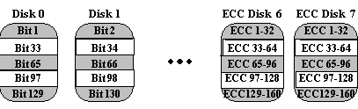
Level2

Slide 12
Level 3
RAID level 3 is similar to RAID level 2, because it uses the same striping method as level 2, but it requires only one disk for parity data. RAID 3 suffers from a write bottleneck, because all parity data is written to a single drive, but provides some read and write performance improvement.

Slide 13
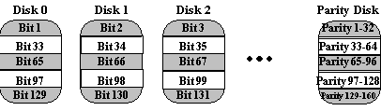
level3

Slide 14
Level 4
RAID level 4 is similar to RAID level 3, because it uses the similar striping method as level 3 and requires only one disk for parity data, but it employs striped data in much larger blocks or segments. RAID level 4 is not as efficient as RAID level 5, because (as in RAID level 3) all parity data is written to a single drive, so RAID level 4 suffers from a write bottleneck and is not generally used.

Slide 15
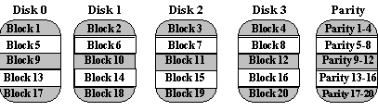
level4

Slide 16
Level 5
RAID level 5 is known as striping with parity. This is the most popular RAID level. It is similar to level 4 in that it stripes the data in large blocks across all the disks in the array. It differs in that it writes the parity across all the disks. The data redundancy is provided by the parity information. The data and parity information are arranged on the disk array so that the two are always on different disks. RAID level 5 has better performance than RAID level 1 and provides fault tolerance.

Slide 17
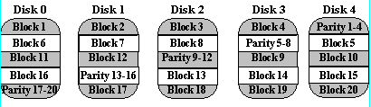
level5

Slide 18
Hybrid RAID Levels:
Some hardware vendors provide hybrid RAID levels combining features of the original RAID levels. Three of the most common hybrid levels are RAID level 10, RAID level 30, and RAID level 50. RAID level 10 is hybrid RAID level that combine mirroring with striping. RAID level 30 and RAID level 50 are hybrid RAID levels that combine parity RAID techniques with data striping

Slide 19
Level 10
RAID level 10 is known as mirroring with striping. This level uses a striped array of disks, which are then mirrored to another identical set of striped disks. RAID level 10 provides the performance benefits of disk striping (level 0) with the disk redundancy of mirroring (level 1). RAID 10 provides the highest read/write performance of any of the Hybrid RAID levels, but uses twice as many disks.

Slide 20
Level 30
RAID level 30 is formed by striping across a number of RAID level 3 sub-arrays. In general, it provides performance better than RAID 3 due to the addition of RAID 0 striping, but is not as efficient as RAID level 0.

Slide 21
Level 50
RAID level 50 is formed by striping across a number of RAID level 5 sub-arrays. In general, it provides performance better than RAID 5 due to the addition of RAID 0 striping, but is not as efficient as RAID level 0. It also provides better fault tolerance than the single RAID level 5. Most of the characteristics of RAID level 50 are similar to those of RAID level 30.
you will eventually be prompted to insert the "package disk". At this point, you should insert your MegaRAID Driver Diskette for SCO Open Server. Press the Enter key to continue.
Step 6. Follow the prompts that are given after it loads the Driver Diskette. You will be instructed to input the device that you will be loading the operating system from. Choose the option for 'SCSI CD-ROM'. Be sure that you have inserted the SCO Open Server CD-ROM Disk into the CD-ROM unit. Other prompts will follow that are self explanatory such as user name and password

Slide 22
RAID Type | Small Read | Small Write | Large Read | Large Write | Storage Efficiency
Level 0 | 1 | 1 | 1 | 1 | 1
Level 1 | 1 | 1/2 | 1 | 1/2 | 1/2
Level 3 | 1/G | 1/G | (G-1)/G | (G-1)/G | (G-1)/G
Level 5 | 1 | max (1/G,1/4) | 1 | (G-1)/G | (G-1)/G
Level 6 | 1 | max (1/G,1/4) | 1 | (G-1)/G | (G-1)/G

Slide 23
Dynamic RAID
Because of the limitations of each RAID level on its own, several flavors of RAID have appeared which attempt to combine the best performance attributes from more than one of the levels. These are called Dynamic RAID3/5, write coalescing etc, and use write buffering to accumulate or coalesce multiple data blocks so that they can be written in one chunk, i.e. alleviating the write penalty which requires multiple reads and writes for each system write operation (see animated diagram in Tutorial page 1). The success of this depends on the application sending lots of sequential data to the RAID. If the data is not sequential then little coalescing can be accomplished.

Slide 24
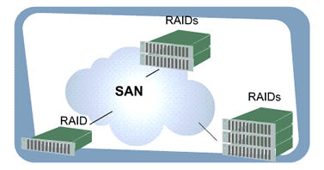
RAID systems

Slide 25
Cont..
1 contemporary SANs include RAID systems as their primary data storage devices
2. First and foremost, RAID systems offer data protection, or fault tolerance
3RAID systems offer very high performance, storage capacity, scalability, and survivability. Other
4reliability features available in today's RAID systems include redundant cooling systems, power supplies, controllers and even monitoring circuitry

Slide 26
Cont..
Modern RAID systems can even permit the direct connection of backup equipment, thus facilitating LAN-free and even serverless data backup and replication

Slide 27
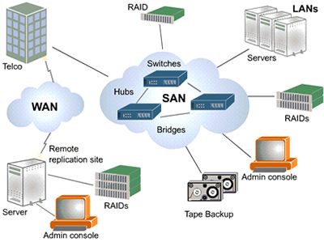
What is a san?

Slide 28
Cont..
1 A SAN, or storage area network, is a dedicated network that is separate from LANs and WANs.
2 It generally serves to interconnect the storage-related resources that are connected to one or more servers
3Centralizing data storage operations and their management is certainly one of the chief reasons that SANs are being specified and deployed today.

Slide 29
ADVANTAGES OF SAN
1 SANs are built up from unique hardware components
2These components are configured together to form the physical SAN itself and usually include a variety of equipment.
3RAID storage systems, hubs, switches, bridges, servers, backup devices, interface cards and cabling all come together to form a storage system that provides the resources that facilitate the policies of an IT organization.

Slide 30
RAID SYSTEMS
Most contemporary SANs include RAID systems as their primary data storage devices

Slide 31
SWITCHES AND HUBS AND BRIDGES

Slide 32
SAN SOFTWARE
1 volume and file management
2date replication
3server clustering
4tape backup applications

Slide 33
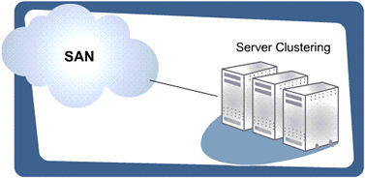
SERVER CLUSTERING

Slide 34
server clustering generally refers to the grouping together of servers for the purpose of enhancing their performance and/or providing failover protection in the event that a member server malfunctions.

Slide 35
ADVANTAGES OF SERVERCLUSTERING
1shared access to resilient disk
2tape backup systems, higher performance data replication options, improved storage scalability, and enhanced resource availability through the inherent advantages of SAN based storage systems.

Slide 36
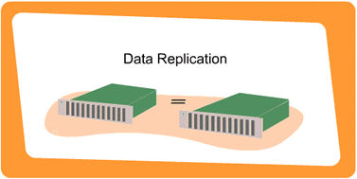
DATAREPLICATION

Slide 37
CONT…
1Data Replication provides many benefits in today's IT environments. For example, it can enable system administrators to create and manage multiple copies of business-critical information across a global enterprise.
2, Internet distribution of file server content, and improve host processing efficiency by moving data sets onto secondary servers for backup operations

Slide 38
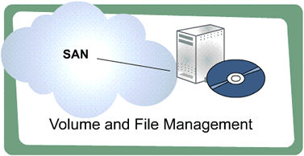
VOLUME AND FILE MANAGEMENT

Slide 39
QUESTIONS ON RAID
1 If, for cost reasons, I try to mirror a slow disk with a fast disk, is the S/W smart enough to balance the reads accordingly or will it all slow down to the speed of the slowest
2 For testing the raw disk thru put... is there a character device for raw read/raw writes instead of /dev/sdaxx that we can use to measure performance on the raid drives?? is there a GUI based tool to use to watch the disk thru-put??

